Slide 1

Introduction to Semantic Link in Microsoft Fabric
Sandeep Pawar | Fabric.guru

Slide 2
Sandeep Pawar
Sr Power BI Architect, Hitachi Solutions (US)
Microsoft Data Platform MVP
Blog: Fabric.guru
@PawarBI

Slide 3
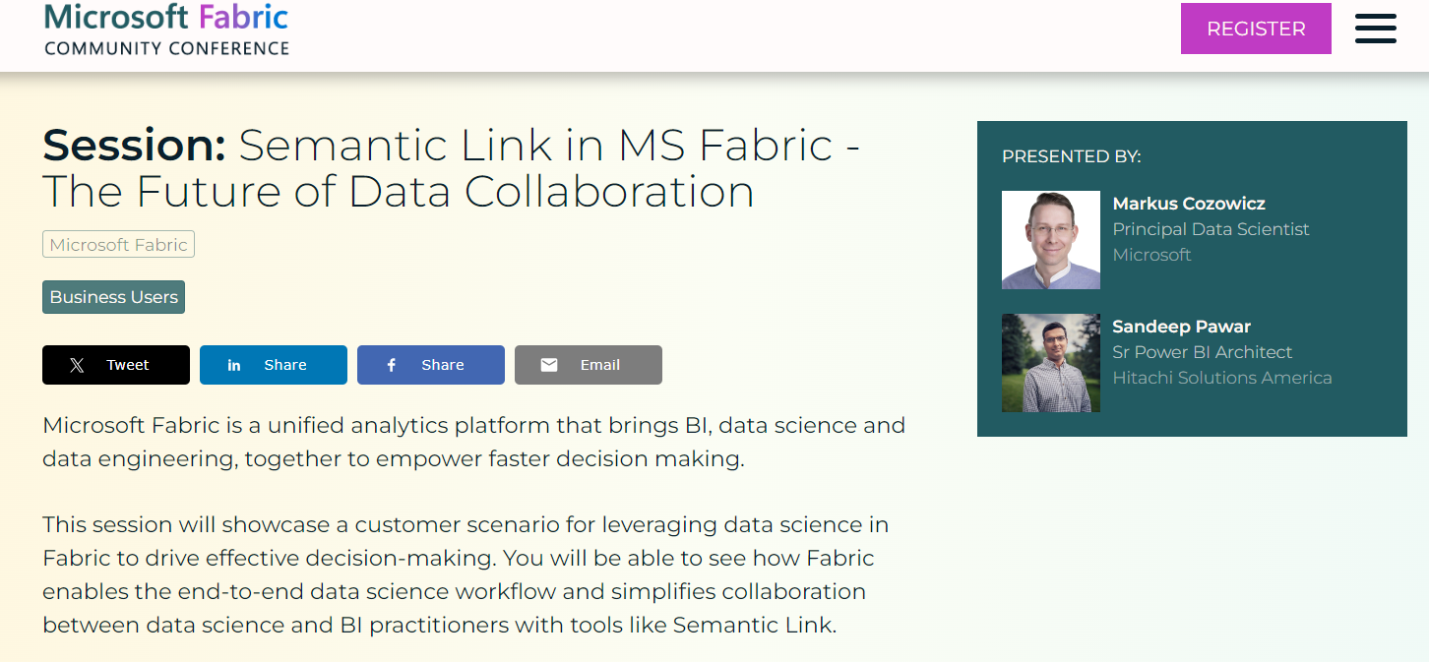
PAWAR100 to get $100 off

Slide 4
Agenda
What Does “Semantic” mean?
What is Semantic Link?
Topics:
Semantic Relationships
Semantic Propagation
Data Science + Power BI
Use cases
Prerequisites:
Experience with Python, Fabric would be helpful but not necessary
Not a session on learning Python, notebooks

Slide 5
Semantic

Slide 6
Semantic Model = Data +
Business Logic + Human concepts + Links/Relationships

